Slide 1

Wilderness Louisville
Website Design
Five Finger Death Punch
Jackson Davis, Noah Anderson, Jack Carter, Micah Herndon, Michael Scroggins, and Mohammad Alwohoush

Slide 2
Agenda
Areas for Improvement
Landing Page Prototype
Other Prototypes
Cost Benefit
Return on Investment

Slide 3
Areas for Improvement
The mission of this project is to identify, analyze, and provide solutions for business process issues in order to grow the organization.
No way to sell merchandise
Cannot easily push content to social media
Users cannot login to system
Donors have trouble finding information

Slide 4
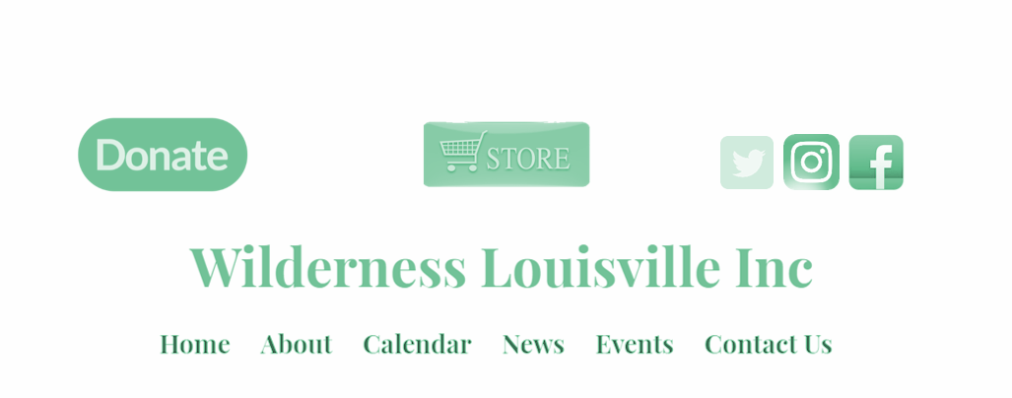



Landing Page Prototype: Blackbaud

Slide 5
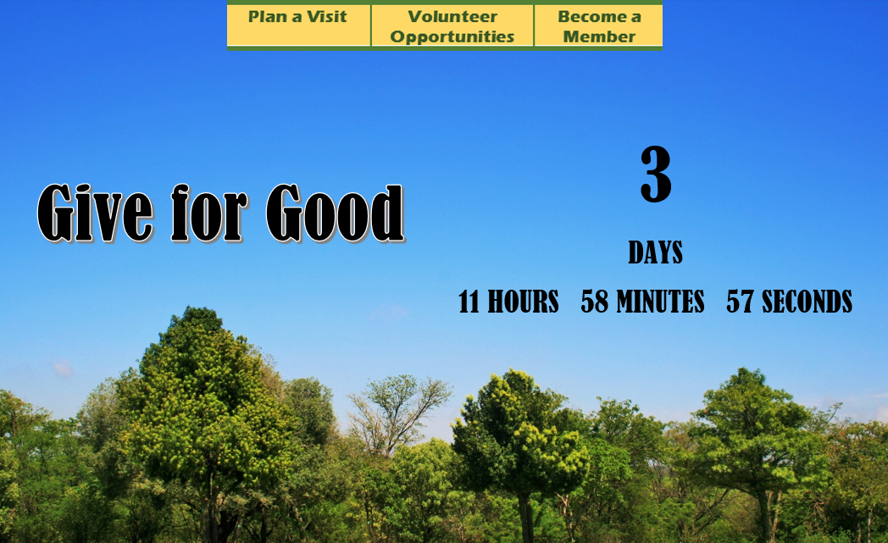

Slide 6
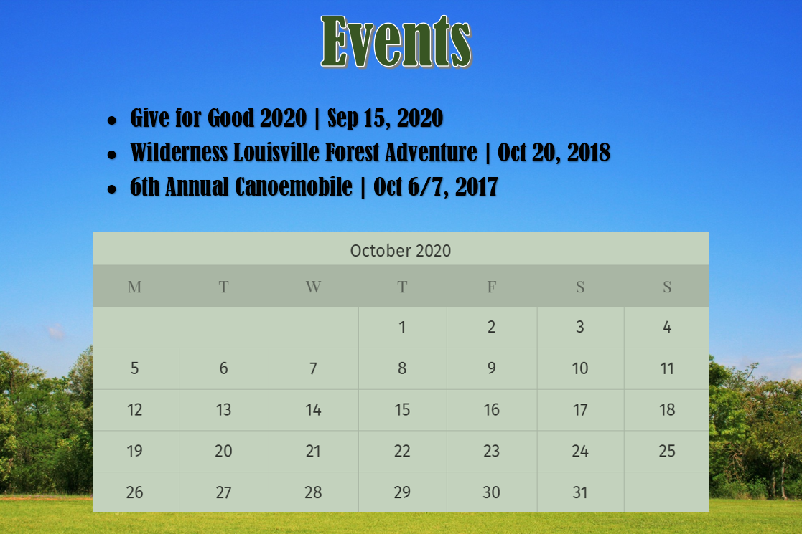

Slide 7
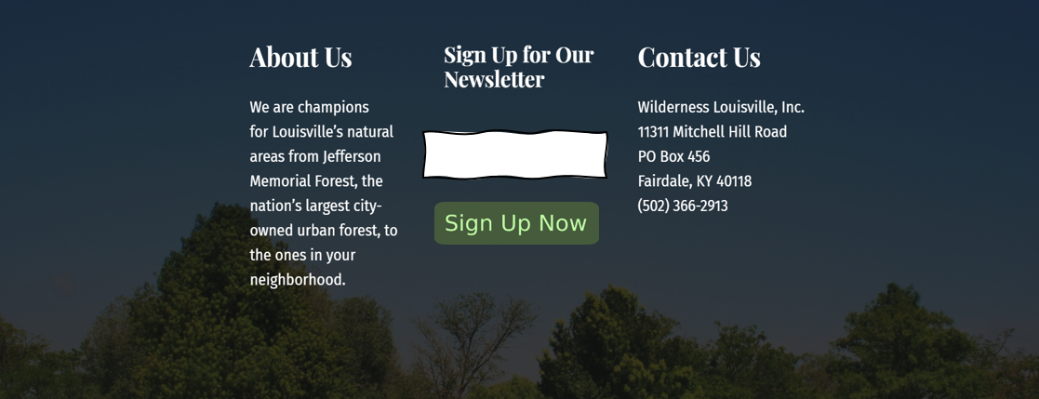


Slide 8

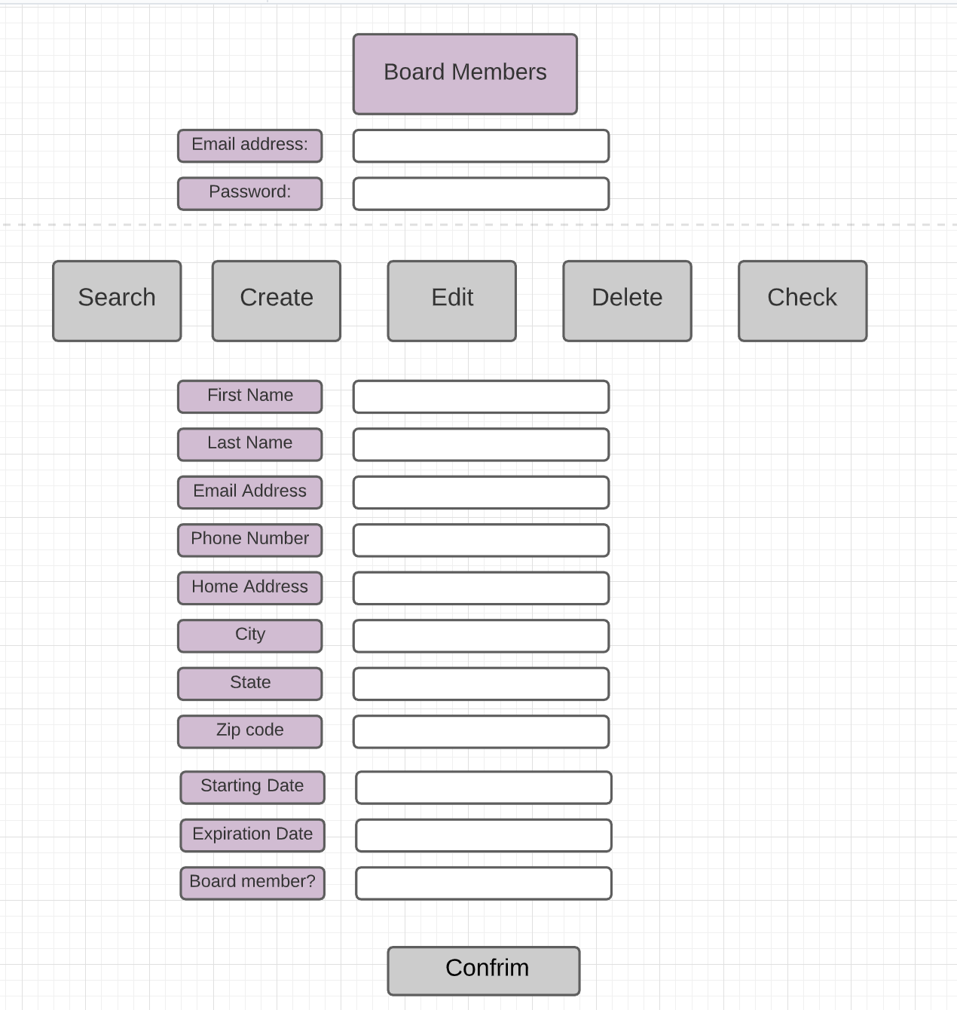

Board Members

Slide 9
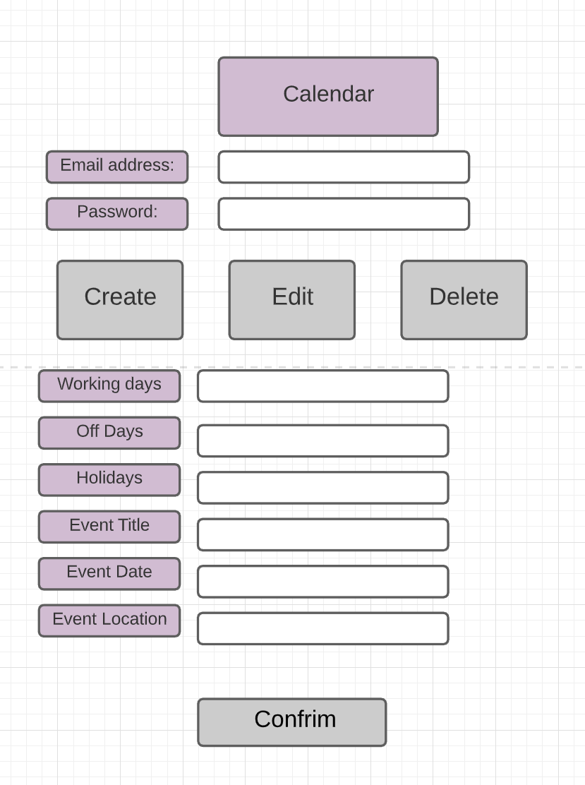
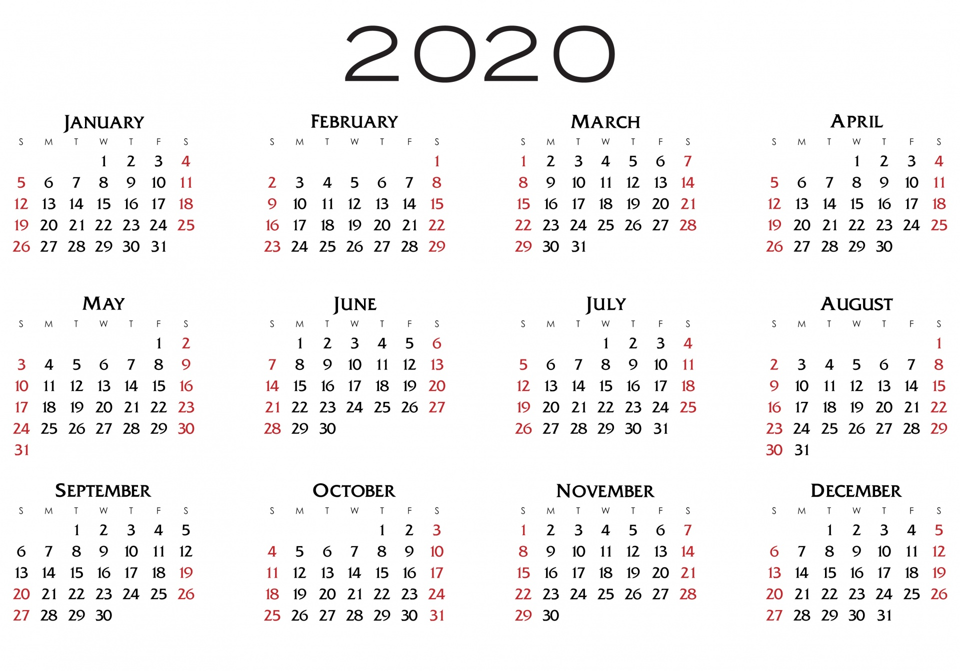
Calendar

Slide 10
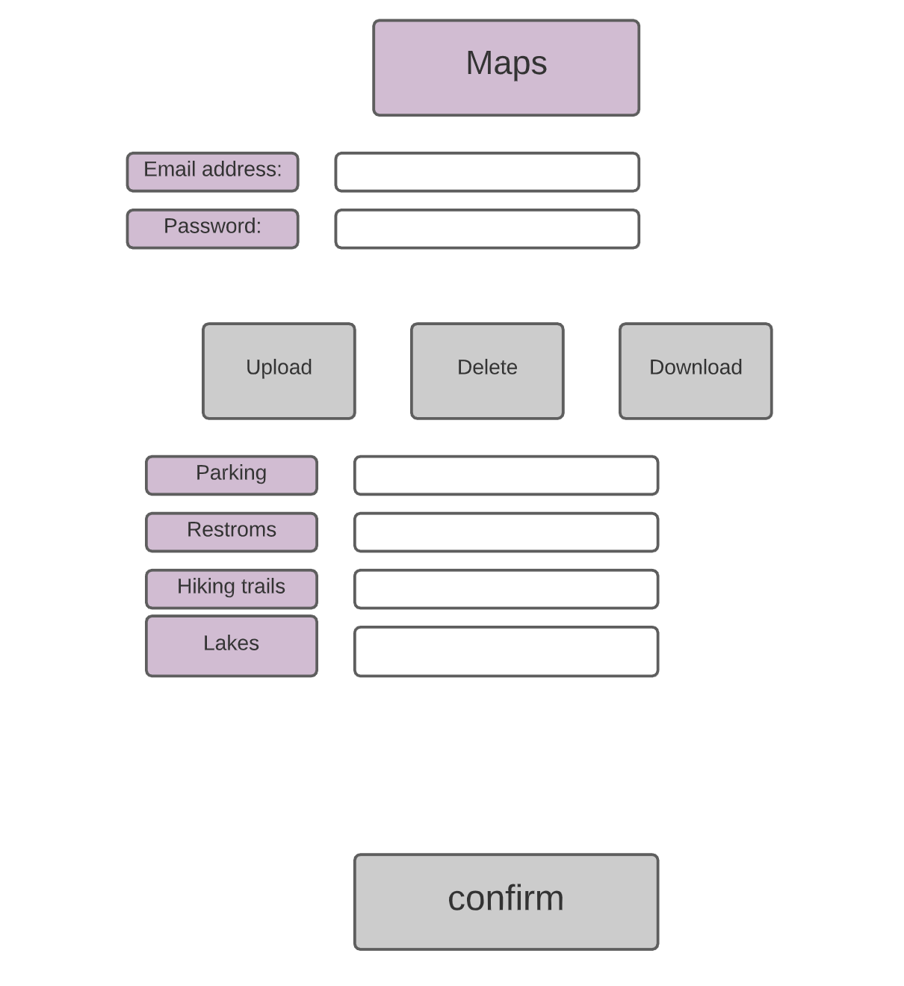
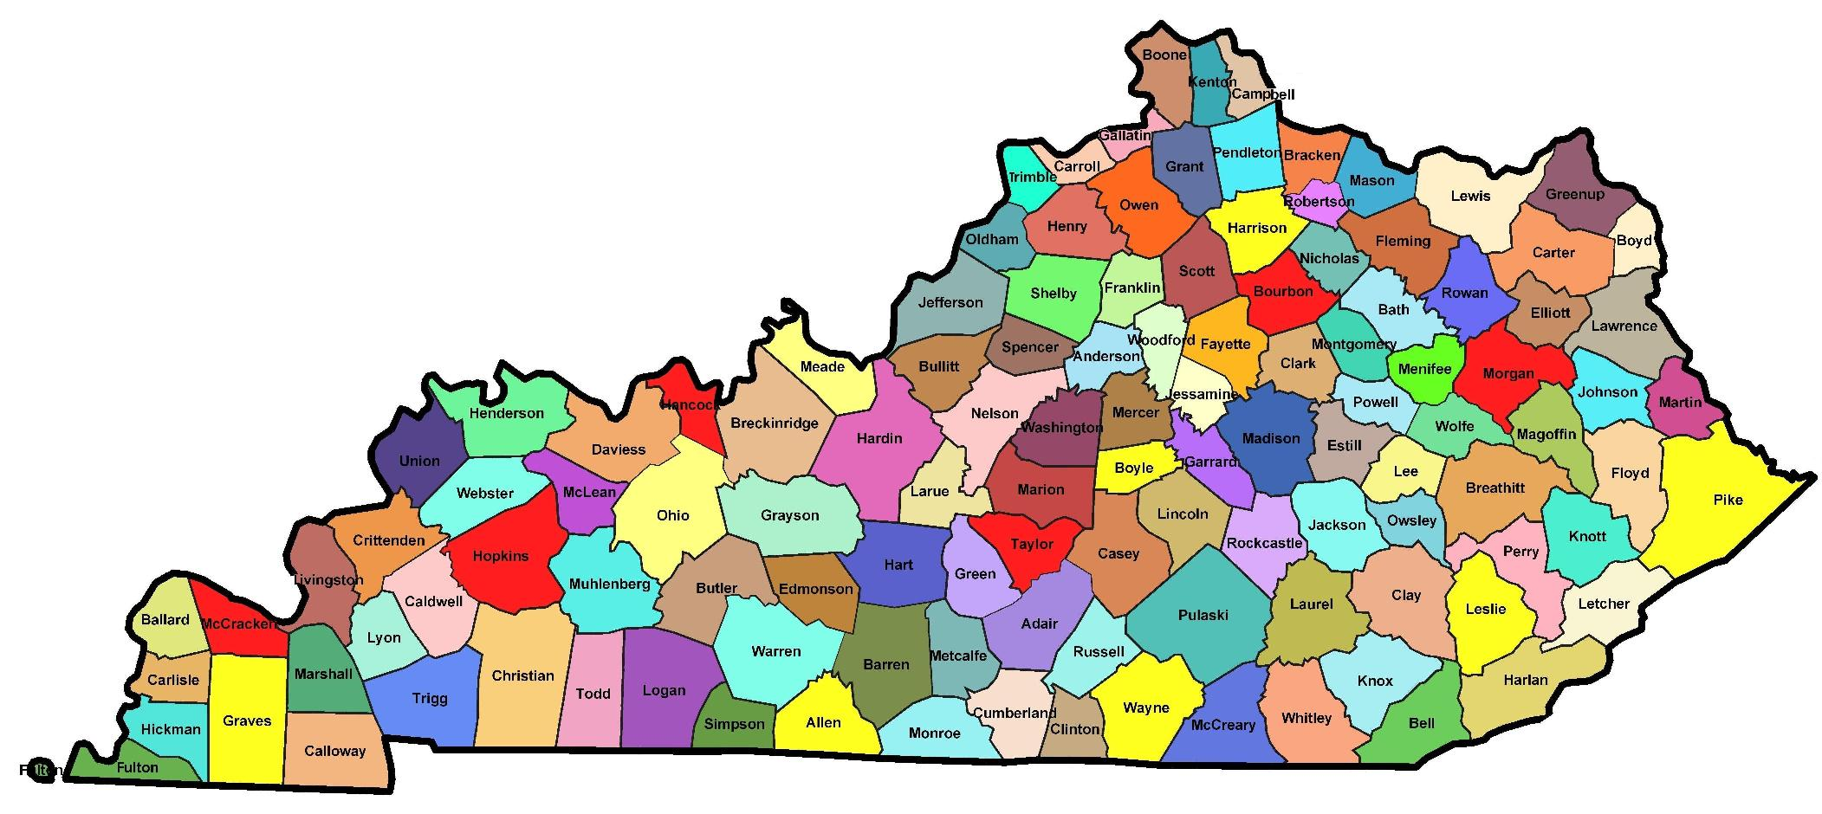
Maps

Slide 11
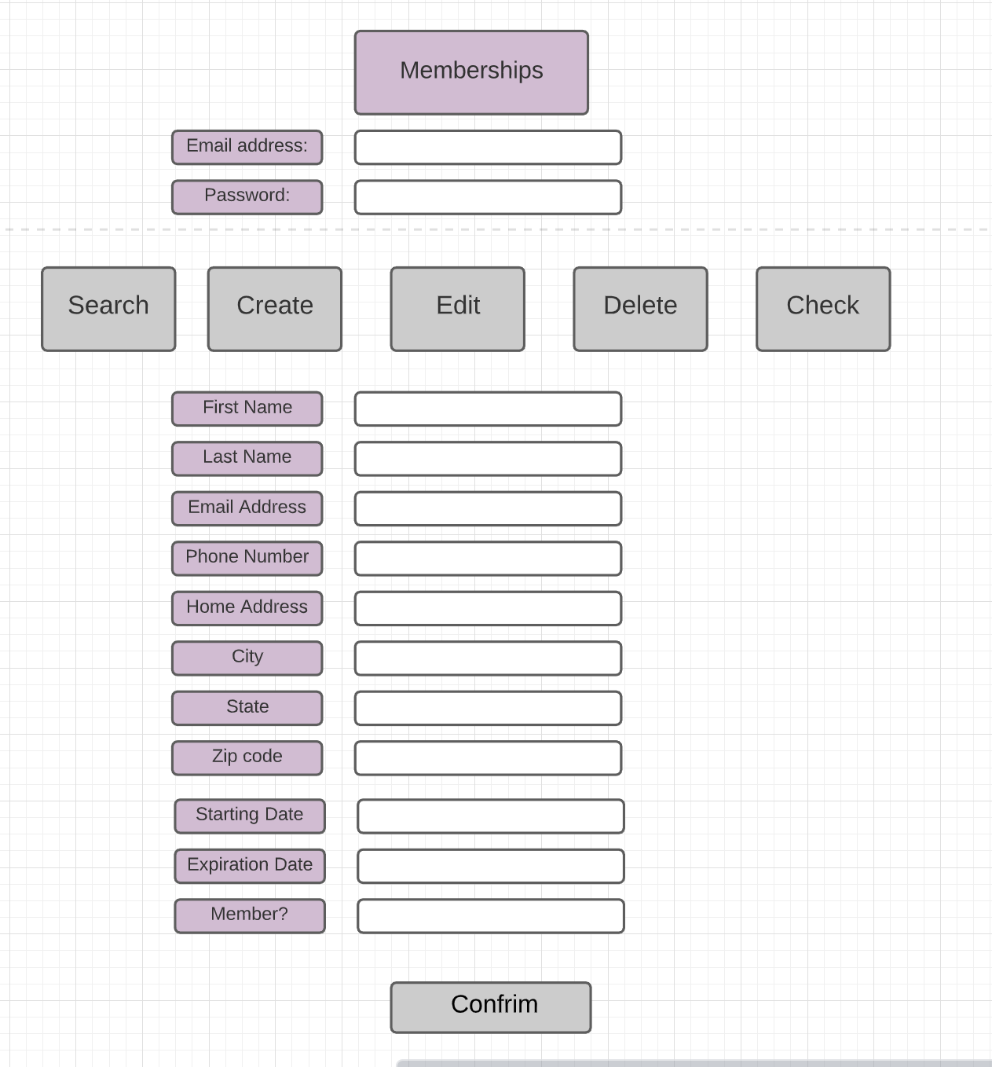

Memberships

Slide 12
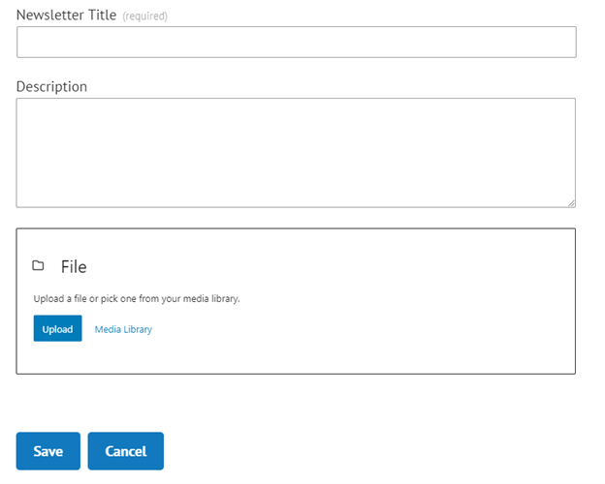

Create Newsletter

Slide 13
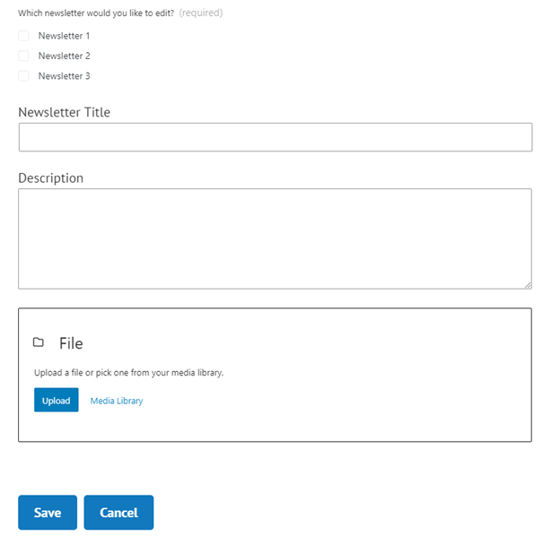

Edit Newsletter

Slide 14
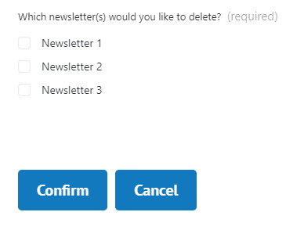

Delete Newsletter

Slide 15
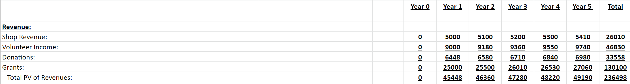
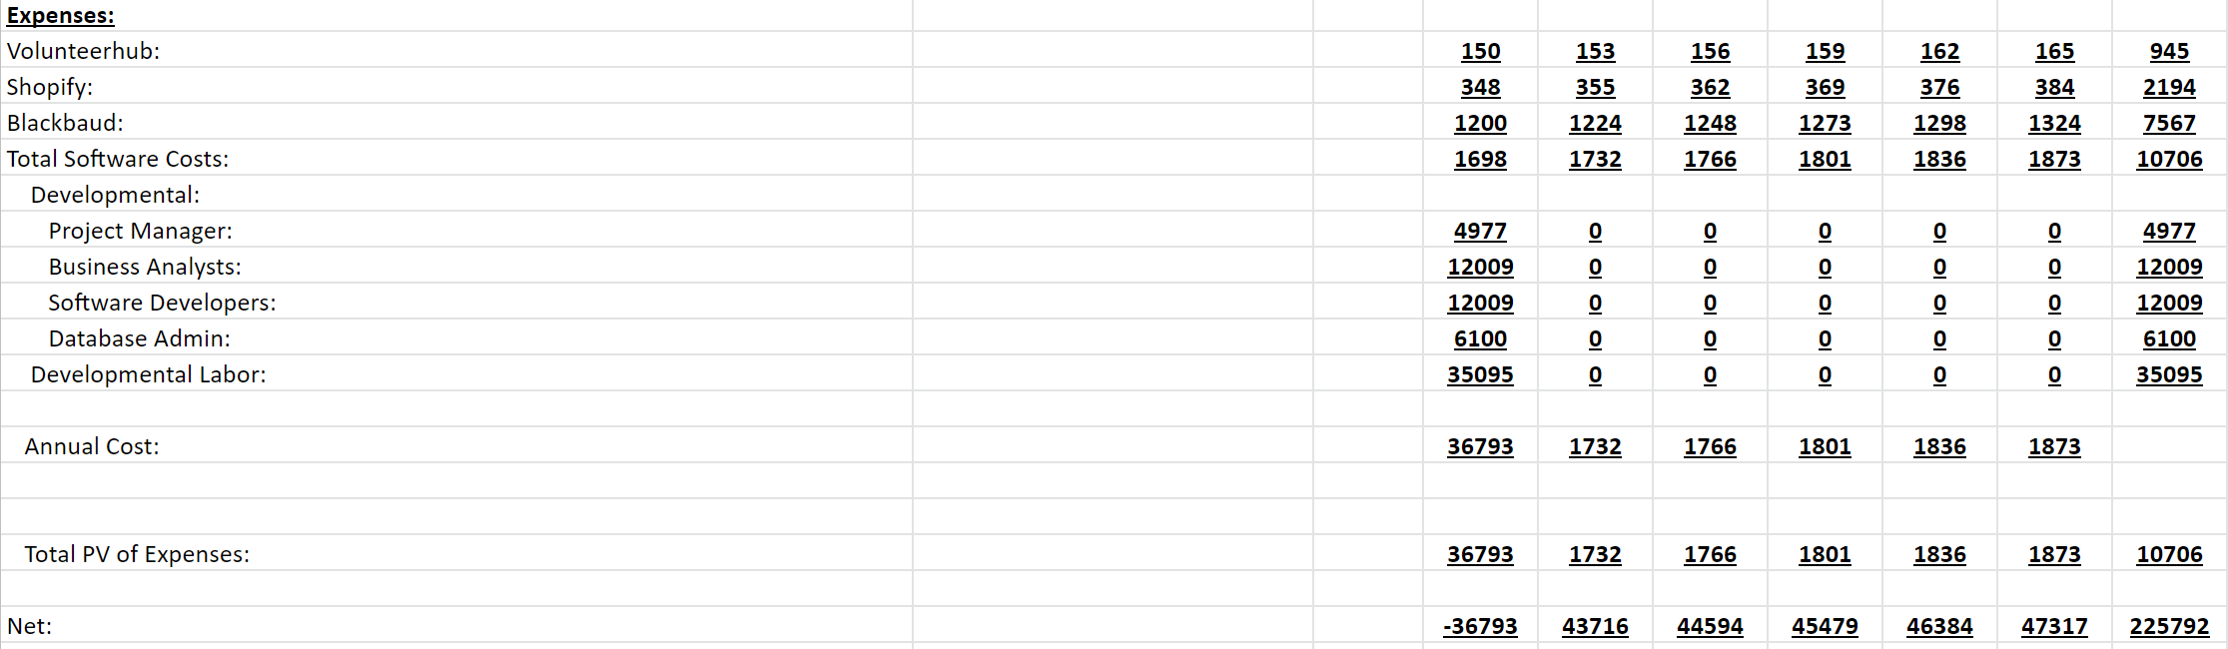
Cost Benefit Analysis
Net without grants
$106,398
-$10,706
$95,692
=
=
ROI
258.8 %

Slide 16

Return On Investment

Slide 17

Questions?

